Slide 1
BeCalm
z
Your first step to a stress-free life

Slide 2
PROBLEM
More than 75% of adults report symptoms of stress, including headache, tiredness, or sleeping problems ^{[1]}
^{[1]} American Psychological Association, 2019

Slide 3
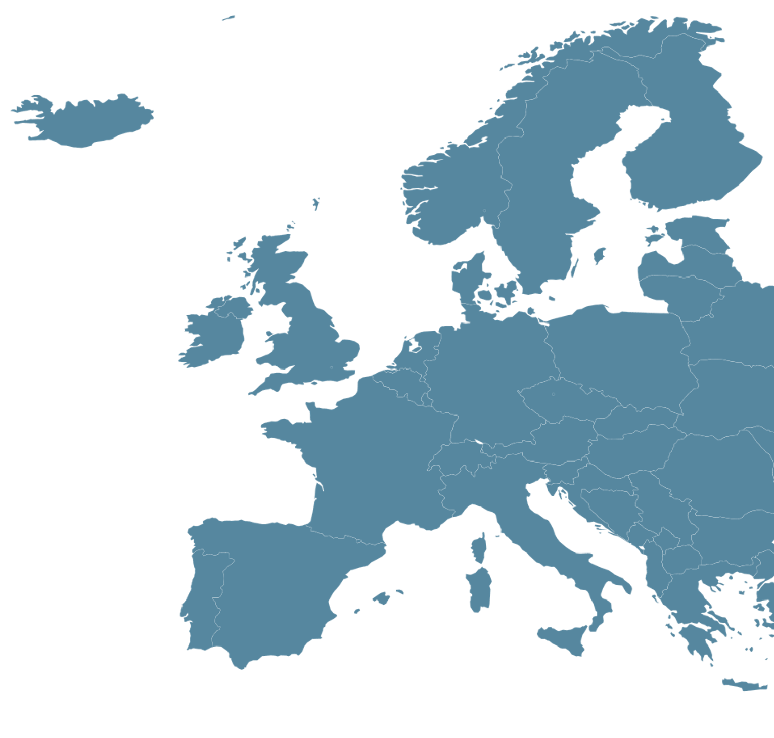
PORTUGAL
3rd country with the highest levels of stress in Europe ^{[2]}
^{[2]} Study from Eachnight

Slide 4
$125 BILLION TO $190 BILLION
in additional health care expenses per year due to stress ^{[3]}
^{[3]} Management Science, 2016

Slide 5
BeCalm
Helps you recognize patterns and habits in your daily life that can induce stress to better handle them in the future
Additional tips to help you relieve stress
App design with calming colors and images

Slide 6

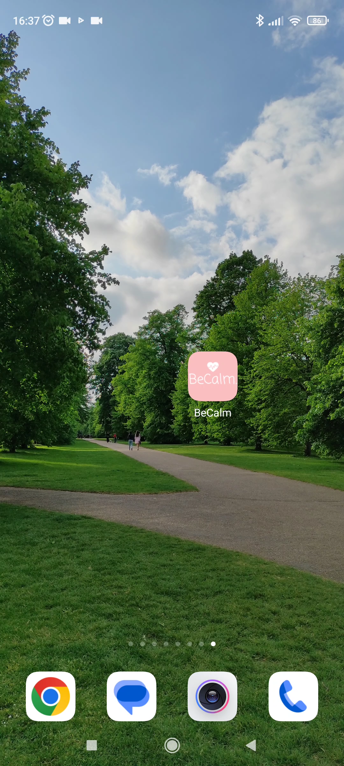

LOGIN PAGE
One-time registration for a personalized experience
Age and gender are used for precise stress level measurement

Slide 7
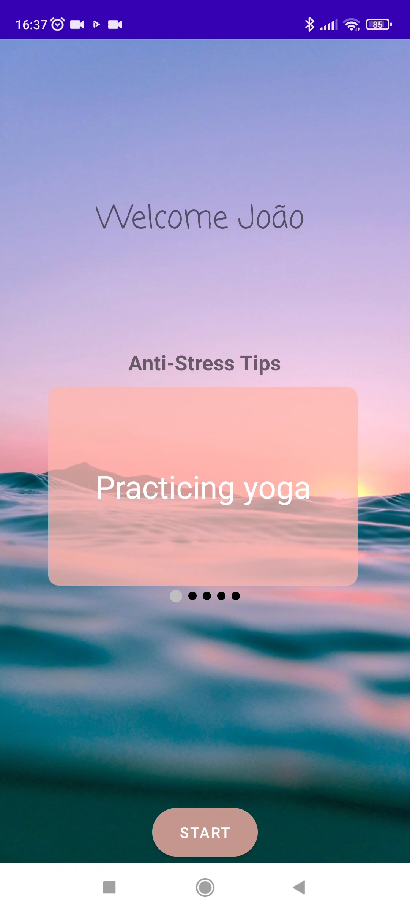
MAIN PAGE
Soothing tones and font
Tips for reducing stress levels, which change with each access

Slide 8

MAIN PAGE
Your information remains stored for ease of use

Slide 9
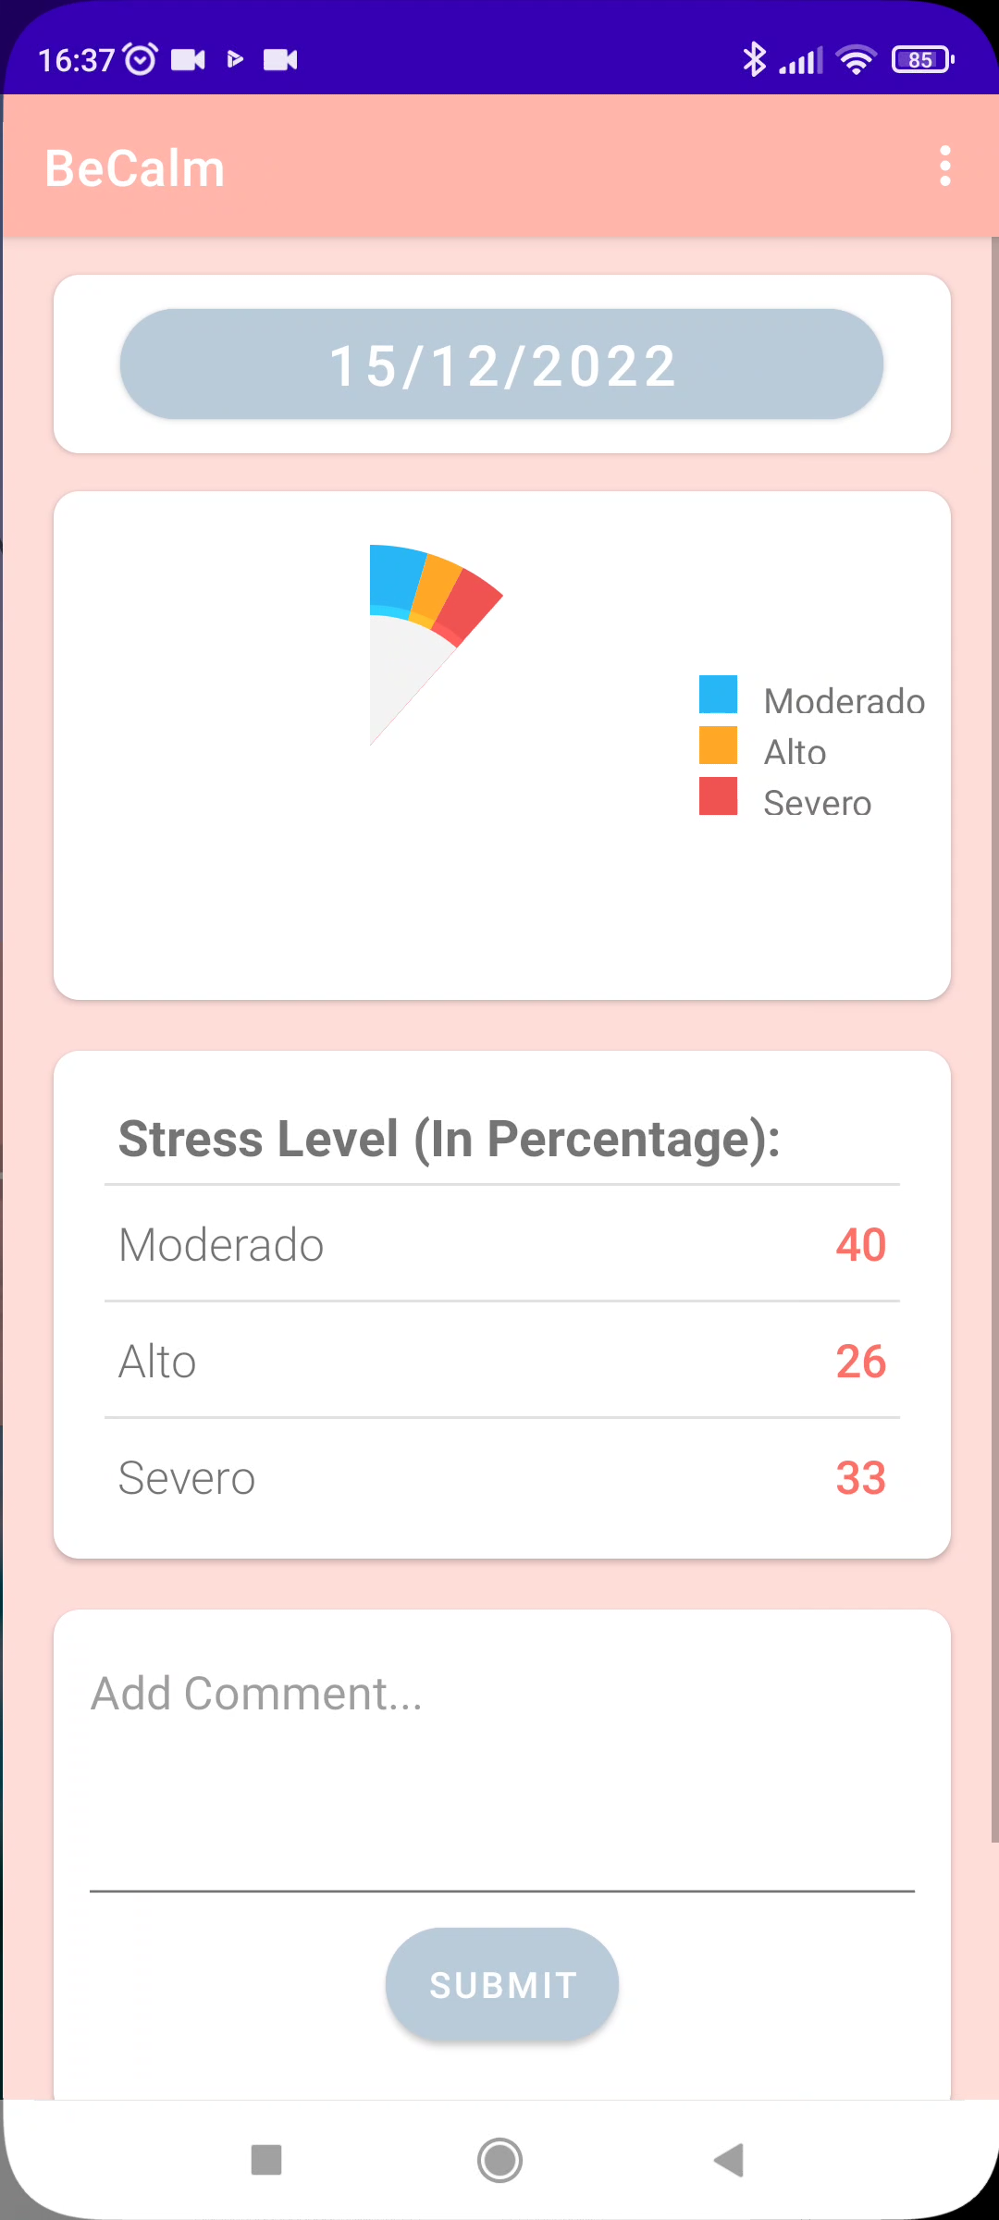

HOME PAGE
Navigate your calendar and see how your stress levels along the days
See how stressed you were throughout the day, in percentage
Add a comment to your day: what made you stressed today?
Press “start acquisition” when you wake up to get a full-day report by the end of the day

Slide 10
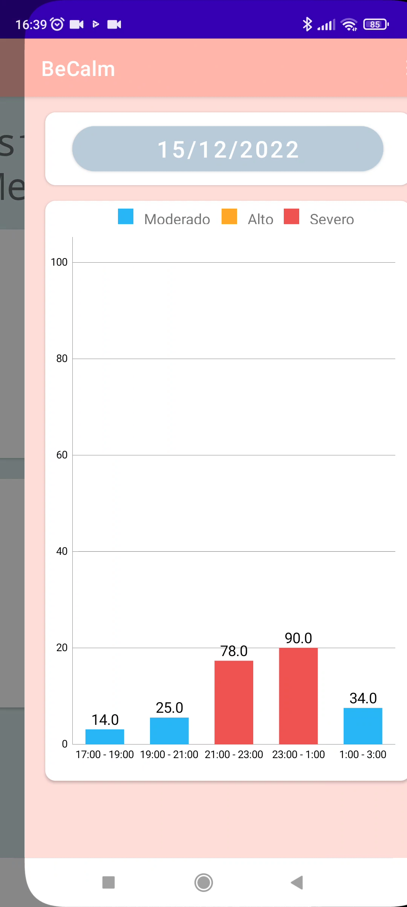
DAILY PAGE
Shows stress levels up to the last day of acquisition
Average stress levels divided in periods of two hours, for each day
Helps pin-point moments of higher stress for precise intervention

Slide 11
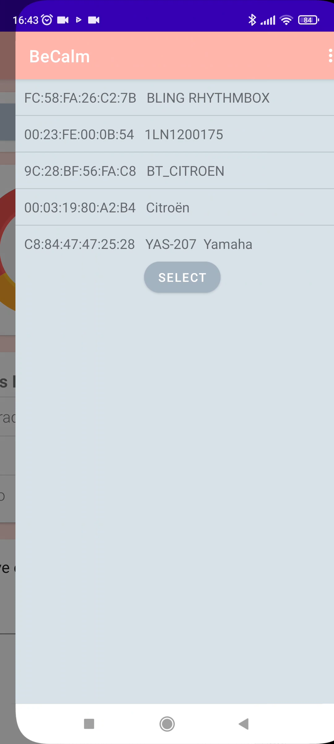
INSTANT MEASUREMENT PAGE
Moderate: 0-40%​
High: 40-70%​
Severe: 70-100%
Signal acquisition for 20 seconds for an instant stress level measurement

Slide 12
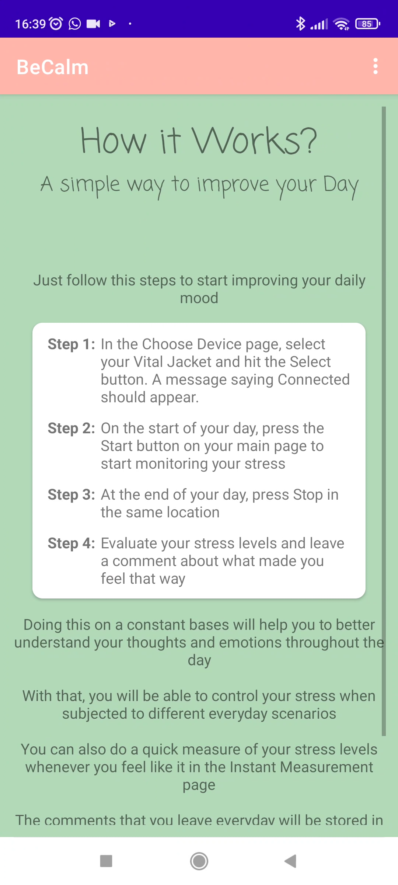
INFO PAGES
HOW IT WORKS
ABOUT
A guide explaining how to use the app and all its functionalities
Has information on the utility of the app, authors, institution and acknowledgements

Slide 13
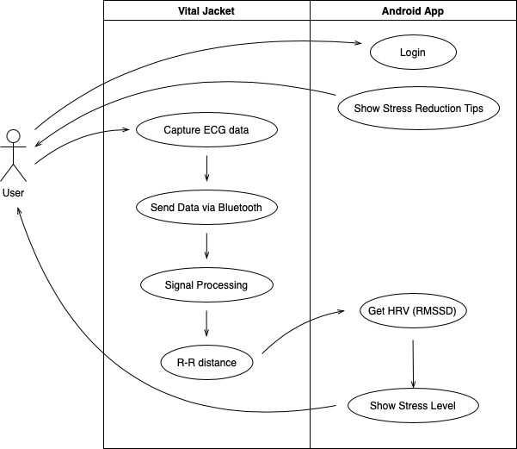
UML DESIGN

Slide 14
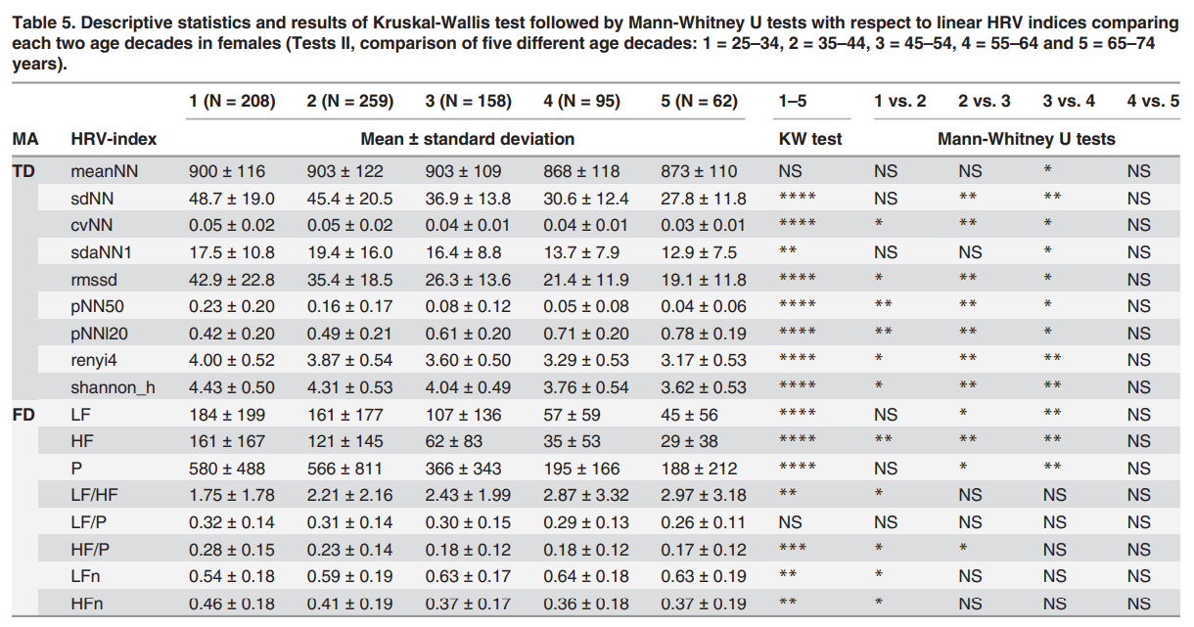
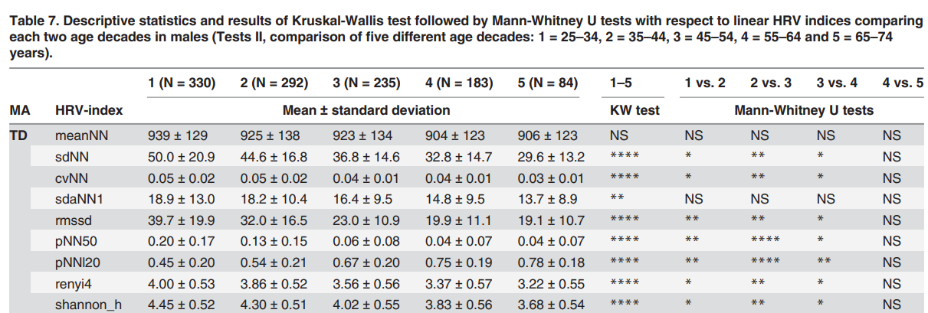
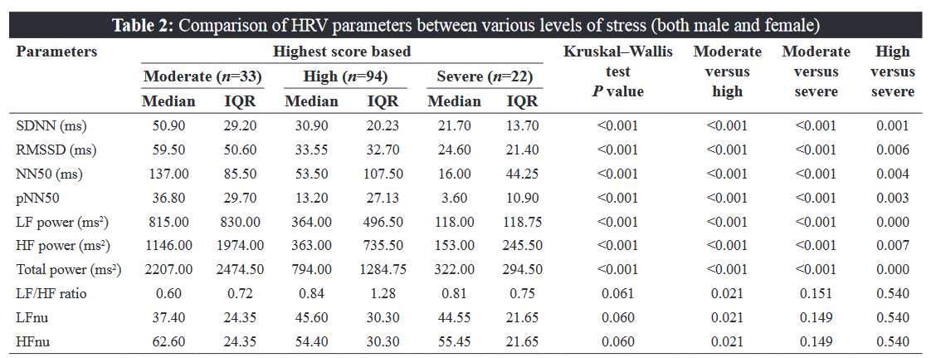
REFERENCE DATA
Males
Females
Age intervals
25 – 34
35 – 44
45 – 54
55 – 64
65 – 74
Medicine students
(male and female)
Voss, A., Schroeder, R., Heitmann, A., Peters, A., & Perz, S. (2015). Short-term heart rate variability - Influence of gender and age in healthy subjects. PLoS ONE, 10(3). https://doi.org/10.1371/journal.pone.0118308
Punita, P., Saranya, K., Chandreasekar, M., & Kumar, S. (2016). Gender difference in heart rate variability in medical students and association with the levels of stress. National Journal of Physiology Pharmacy and Pharmacology 6(5):1. DOI:10.5455/njppp.2016.6.0102325042016

Slide 15
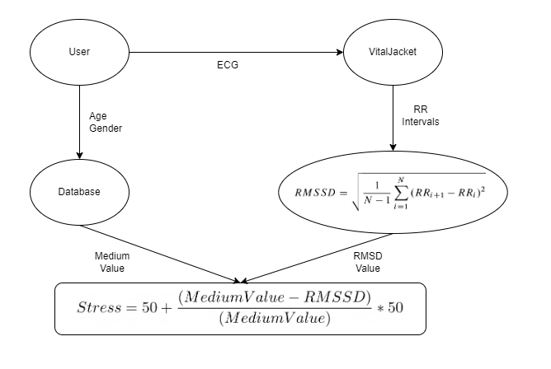
MATH BEHIND

Slide 16
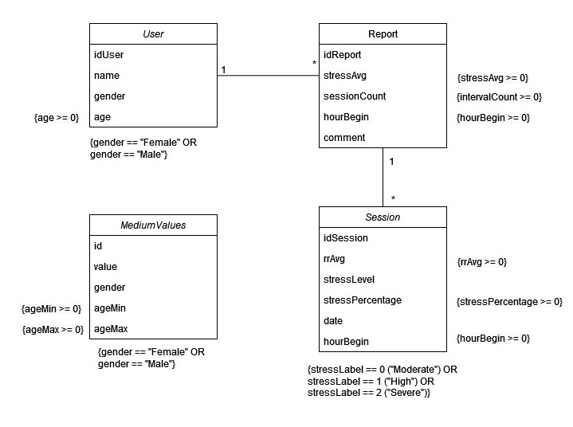
DATABASE

Slide 17
NEXT STEPS
02.
01.
03.
LOGBOOK IMPLEMENTATION
BACKGROUND MONITORING
Option for the users to add daily entries
Measurement of stress levels throughout the whole day
04.
WEEKLY REPORT
BREATH PAGE
Display stress levels per day, within a week
Page with guided breathing instructions

